Slide 1
Flight Delays
Sarah Mansoor, Albert Yu, Meet Kothari
Notes:
Sarah

Slide 2
Agenda
1
2
3
4
Business Problem
Exploratory Analysis
Results
Recommendations
Notes:
Sarah

Slide 3
1
Business Problem
Notes:
Sarah

Slide 4
Business Problem, Motivation, and Dataset
Business Problem
Identify which factors influence the timings of the flights and cause delays for 4 major US airlines
Motivation
Every year thousands of flights are delayed and airlines lose millions of dollars
Dataset
Flight delay information from the Bureau of Transportation Statistics of the United States Department of Transportation from 2012-2017
Notes:
Sarah

Slide 5
2
Exploratory
Analysis
Notes:
Sarah

Slide 6
Exploratory Analysis
Different Types of Delays
By Airport
By Airline and Airport
Weather, Late Aircraft, NAS, Security, Carrier
Average delays in each airport
Top 10 Delays by Airline and Airport
Notes:
Sarah

Slide 7
Exploratory Analysis
Year
Month
Cancelled Flights
Number of Arriving Flights
Notes:
Sarah

Slide 8
3
Results
Notes:
Albert

Slide 9
Results
Different Types of Delays
Weather, Late Aircraft, NAS, Security, Carrier
Notes:
Albert

Slide 10
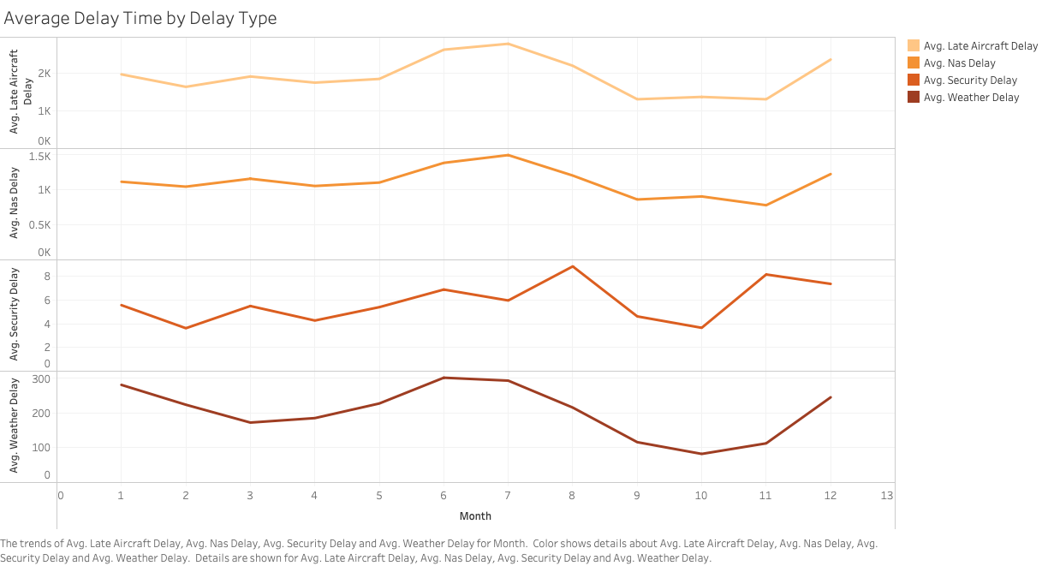
Notes:
Albert

Slide 11
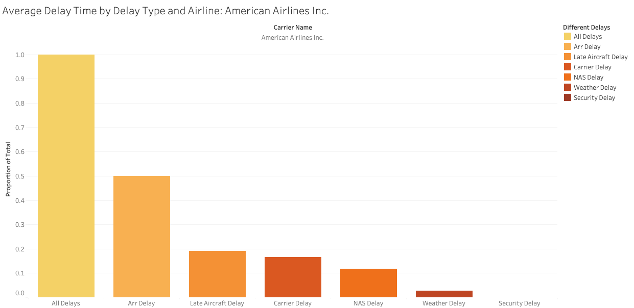
Notes:
Albert

Slide 12
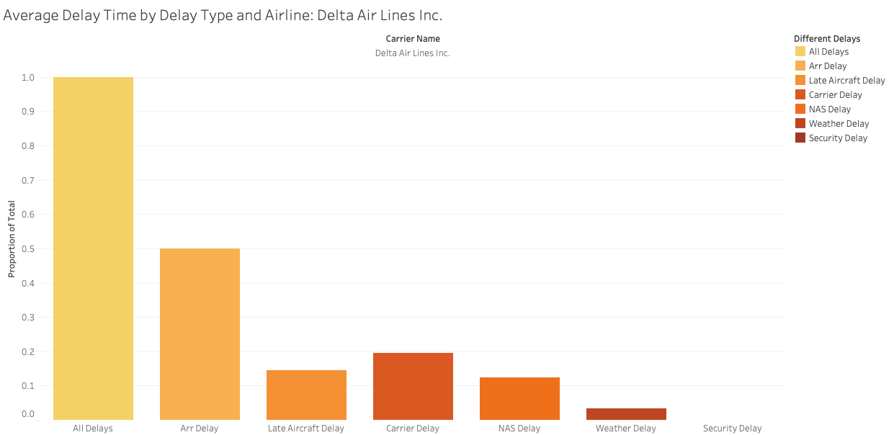
Notes:
Albert

Slide 13
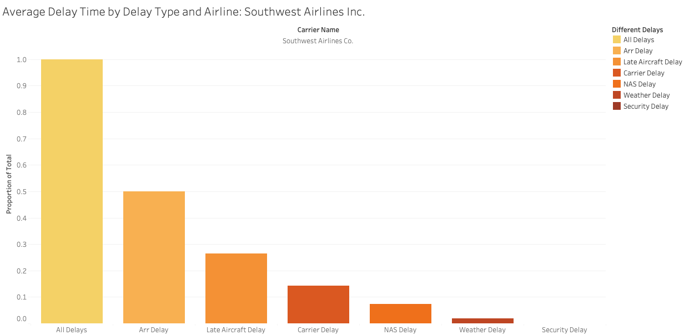
Notes:
Albert

Slide 14
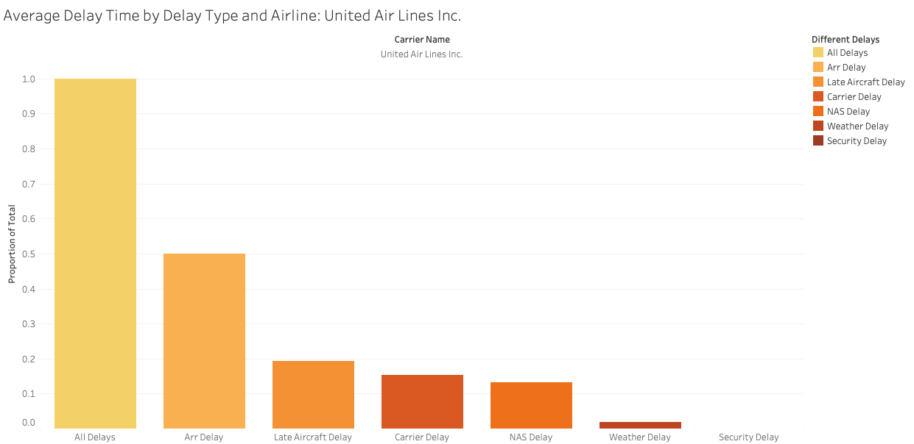
Notes:
Albert

Slide 15
Results
Different Types of Delays
By Airport
Weather, Late Aircraft, NAS, Security, Carrier
Average delays in each airport
Notes:
Meet

Slide 16
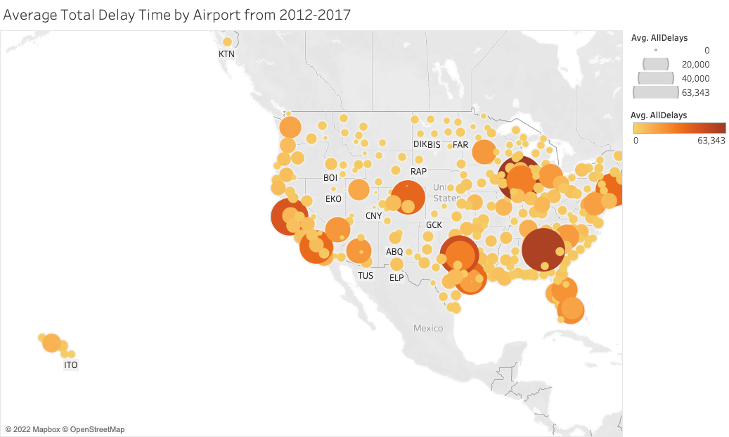
Notes:
Meet

Slide 17
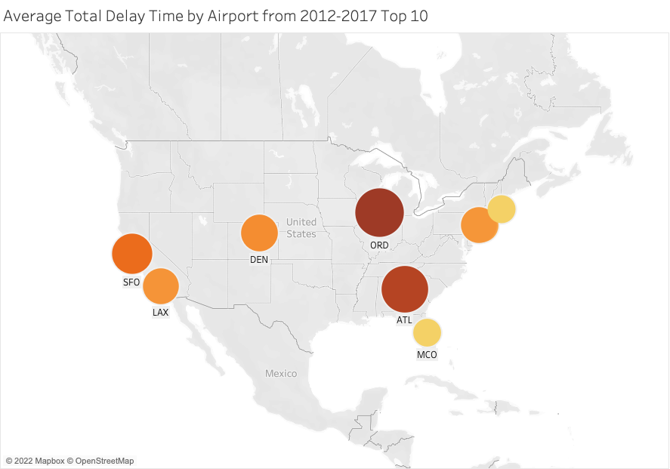
Notes:
Meet

Slide 18
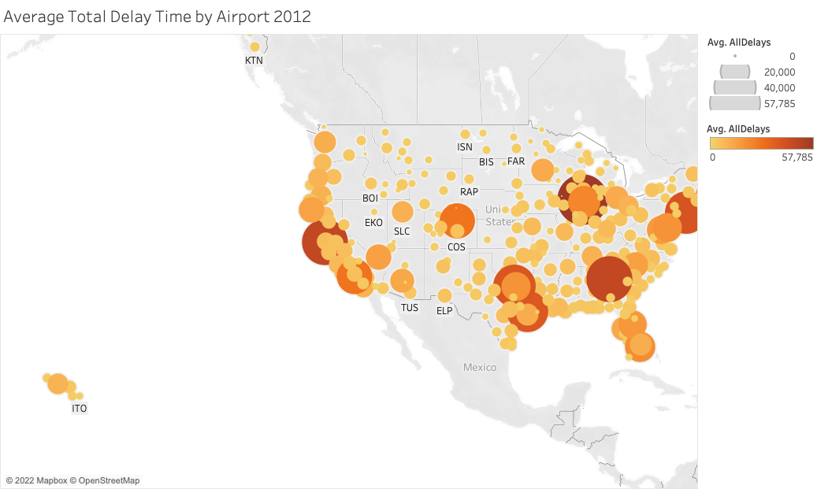
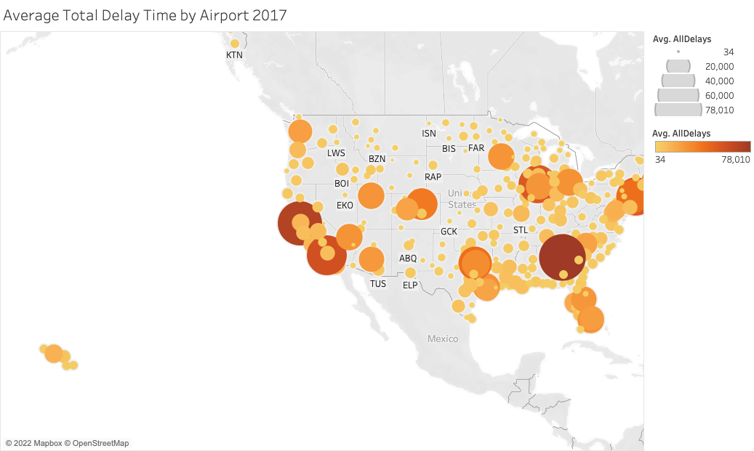
Notes:
Meet

Slide 19
Results
Different Types of Delays
By Airport
By Airline and Airport
Weather, Late Aircraft, NAS, Security, Carrier
Average delays in each airport
Top 10 Delays by Airline and Airport
Notes:
Sarah

Slide 20
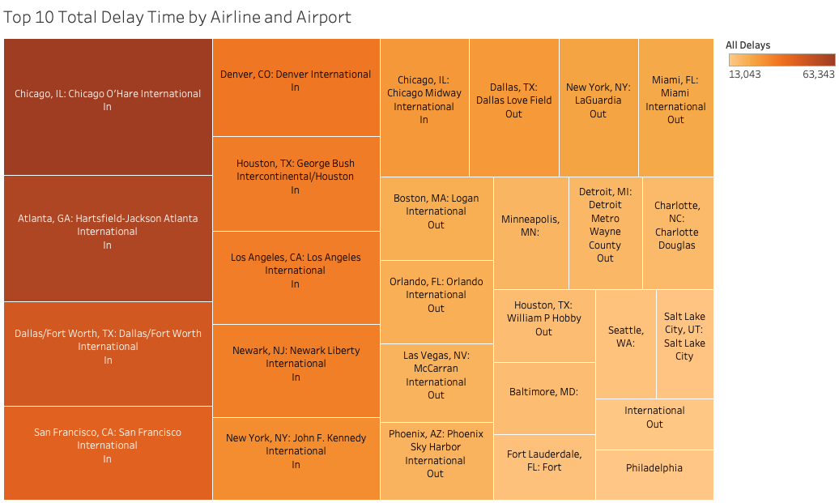
Notes:
Sarah

Slide 21
Results
Year
Notes:
Albert

Slide 22
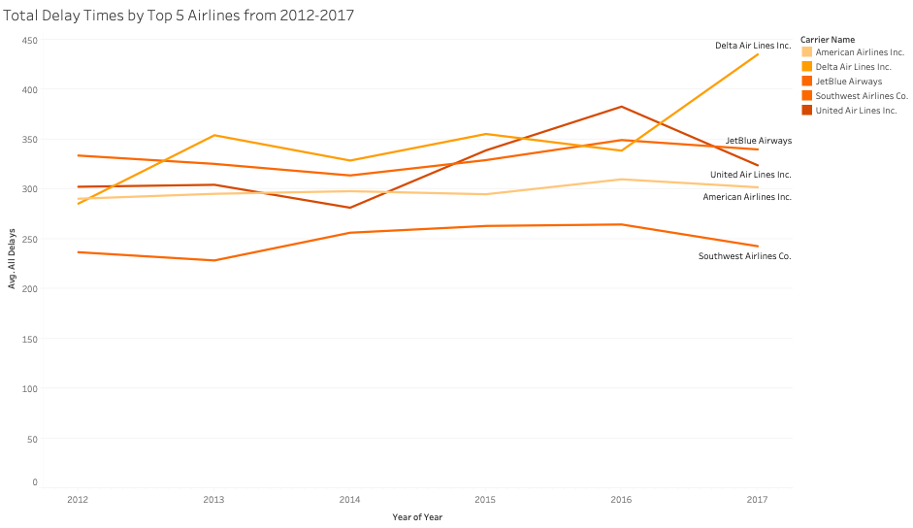
Notes:
Albert

Slide 23
Exploratory Analysis
Year
Month
Notes:
Meet

Slide 24
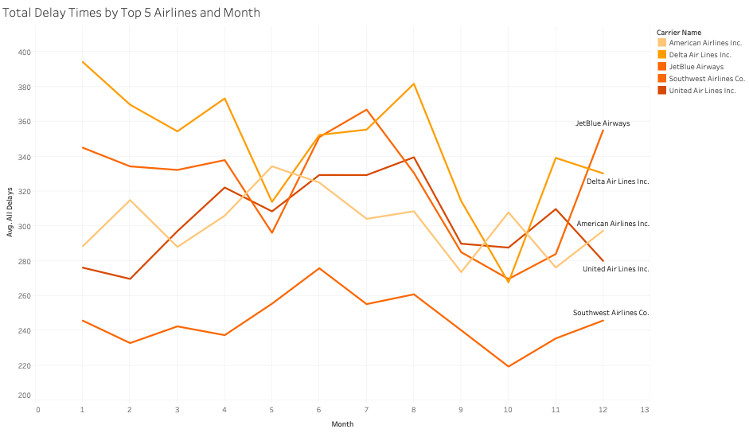
Notes:
Meet

Slide 25
Results
Year
Month
Cancelled Flights
Notes:
Sarah

Slide 26
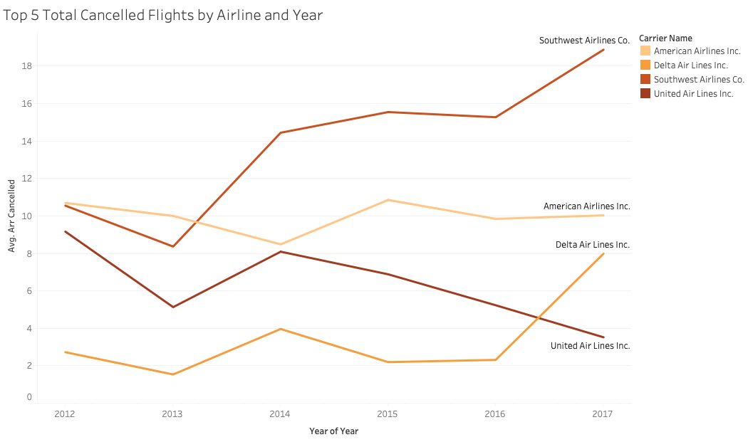
Notes:
Sarah

Slide 27
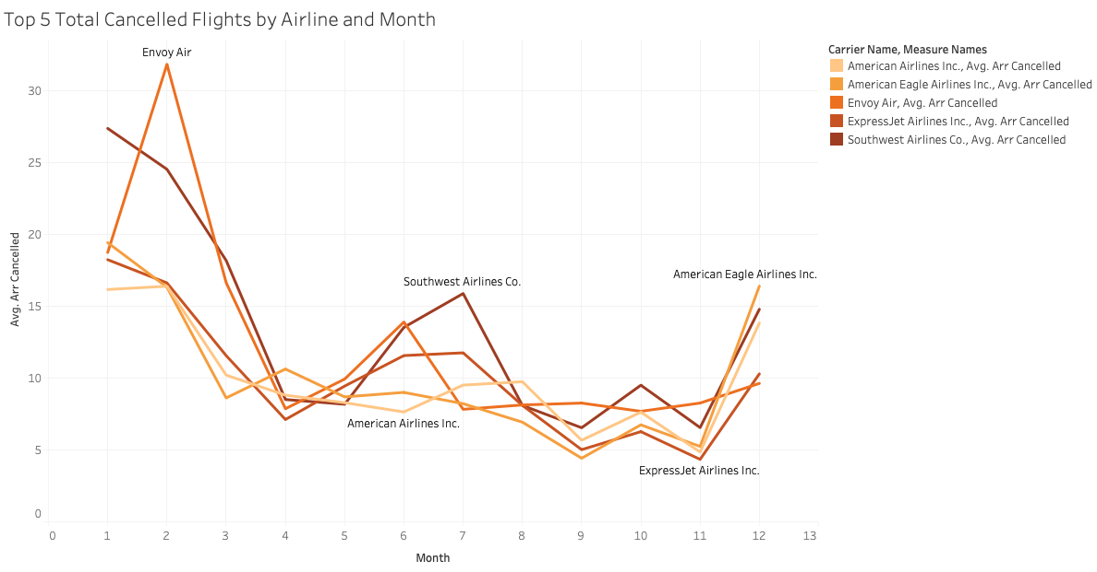
Notes:
Sarah

Slide 28
Results
Cancelled Flights
Number of Arriving Flights
Year
Month
Notes:
Sarah

Slide 29
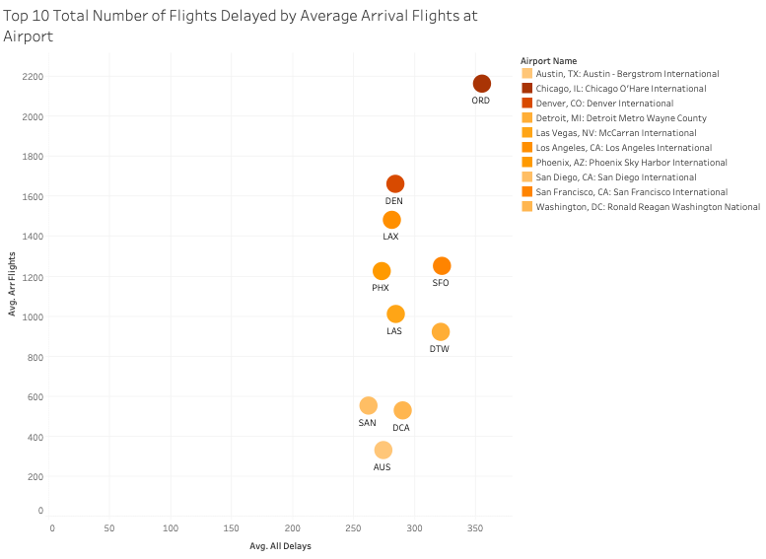
Notes:
Sarah

Slide 30
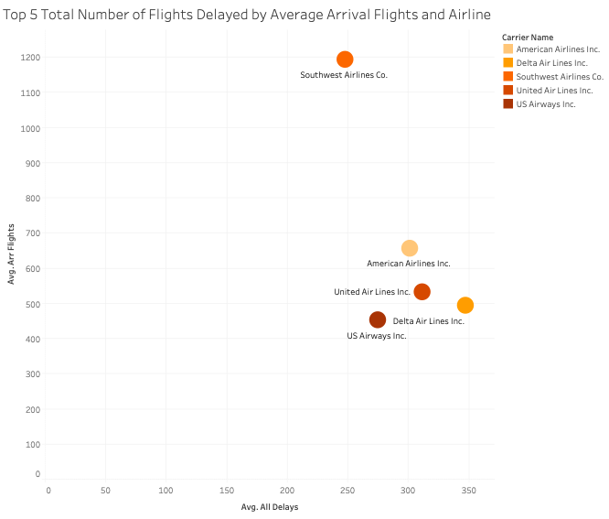
Notes:
Sarah

Slide 31
4
Recommendations
Notes:
Meet

Slide 32
Recommendations
Late Aircraft Delay
Carrier Delay
Arrival Delay
Southwest Airlines
Delta Airlines
All 4 Airlines
Notes:
Meet

Slide 33
Recommendations
Total Delay Time | Atlanta and California
American Airlines | New York and California
Delta Airlines | New York and California
Southwest Airlines | Florida and California
United Airlines | Washington and Boston
Cancellations | Southwest in July and August
Notes:
Meet

Slide 34
THANK
YOU

